Slide 1
Regression Analysis
Regression Analysis in Practice
Nicoleta Serban, Ph.D.
Professor
Stewart School of Industrial and Systems Engineering
Emergency Department Healthcare Costs : Model Fit and Assessment

Slide 2

About This Lesson

Slide 3
Multiple Linear Regression Model
## Exclude GEOID, scaling factor PMPM, and confounding factors EDCost and ED
## Exclude OtherPop & ComplexPop because of linear dependence
dataAdult.red = dataAdult[, -c(1, 3, 4, 5, 10, 13)]
fullmodel = lm(log(EDCost.pmpm) ~ ., data=dataAdult.red)
summary(fullmodel)

Slide 4
Multiple Linear Regression Model
 | Estimate | Std. Error | t value | Pr(>|t|)
(Intercept) | 2.208e+00 | 1.175e-01 | 18.788 | < 2e-16 ***
StateAR | 9.235e-01 | 1.610e-02 | 57.353 | < 2e-16 ***
StateLA | 9.081e-01 | 1.358e-02 | 66.853 | < 2e-16 ***
StateNC | 1.418e+00 | 1.650e-02 | 85.909 | < 2e-16 ***
HO | 1.168e+01 | 7.587e-01 | 15.401 | < 2e-16 ***
PO | 1.378e-01 | 4.114e-02 | 3.350 | 0.000815 ***
WhitePop | 4.416e-03 | 5.800e-04 | 7.614 | 3.16e-14 ***
BlackPop | 4.894e-03 | 5.824e-04 | 8.403 | < 2e-16 ***
HealthyPop | -9.044e-04 | 8.160e-04 | -1.108 | 0.267751
ChronicPop | -5.949e-03 | 2.052e-03 | -2.899 | 0.003760 **
Unemployment | 4.390e-04 | 7.377e-04 | 0.595 | 0.551797
Income | -2.556e-07 | 2.774e-07 | -0.922 | 0.356769
Poverty | -3.306e-04 | 4.460e-04 | -0.741 | 0.458529
Education | -1.447e-03 | 3.296e-04 | -4.390 | 1.16e-05 ***
UrbanicitySuburban | -4.565e-04 | 1.369e-02 | -0.033 | 0.973406
UrbanicityUrban | 2.067e-02 | 1.269e-02 | 1.629 | 0.103356
Accessibility | -1.965e-03 | 7.094e-04 | -2.770 | 0.005623 **
Availability | 8.037e-02 | 1.975e-02 | 4.068 | 4.81e-05 ***
RankingsPCP | 7.596e-04 | 1.819e-04 | 4.175 | 3.03e-05 ***
RankingsFood | 6.586e-03 | 5.203e-03 | 1.266 | 0.205642
RankingsHousing | -4.642e-03 | 1.562e-03 | -2.973 | 0.002967 **
RankingsExercise | 3.993e-04 | 2.332e-04 | 1.712 | 0.086907 .
RankingsSocial | -3.895e-04 | 1.347e-03 | -0.289 | 0.772497
ProvDensity | 6.042e-02 | 1.573e-02 | 3.841 | 0.000124 ***
Socioeconomic predicting variables Unemployment, Income, Poverty and RankingsSocial are not statistically significant given other predicting variables in the model.
Access to primary care variables Accessibility and Availability are statistically significant.
85% of the variability in the ED cost is explained.
---
Signif. codes: 0 ‘***’ 0.001 ‘**’ 0.01 ‘*’ 0.05 ‘.’ 0.1 ‘ ’ 1
Residual standard error: 0.2321 on 4995 degrees of freedom
Multiple R-squared: 0.8486, Adjusted R-squared: 0.8479
F-statistic: 1218 on 23 and 4995 DF, p-value: < 2.2e-16

Slide 5
Residual Analysis: Outliers & Normality
## Residuals versus individual predicting variables
full.resid = residuals(fullmodel)
cook = cooks.distance(fullmodel)
## Check outliers
influencePlot(fullmodel)
plot(cook, type="h", lwd=3, col="red", ylab="Cook's Distance")
## Check Normality
qqPlot(full.resid, ylab="Residuals", main = "")
qqline(full.resid, col="red", lwd=2)
hist(full.resid, xlab="Residuals", main = "", nclass=30, col="orange")

Slide 6
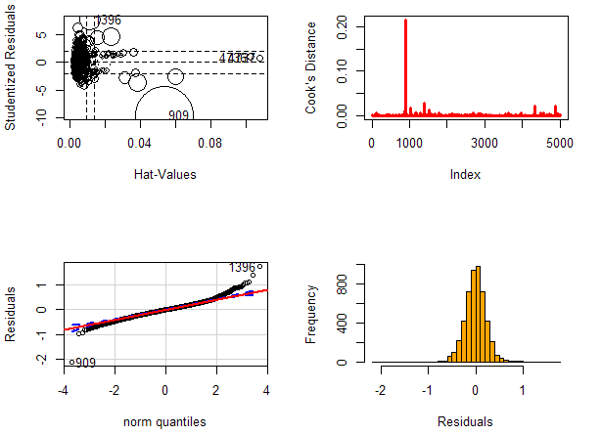
Residual Analysis: Outliers & Normality
Outliers
Observation 909 stands out.
Normality
Symmetric, but with heavy tails.

Slide 7
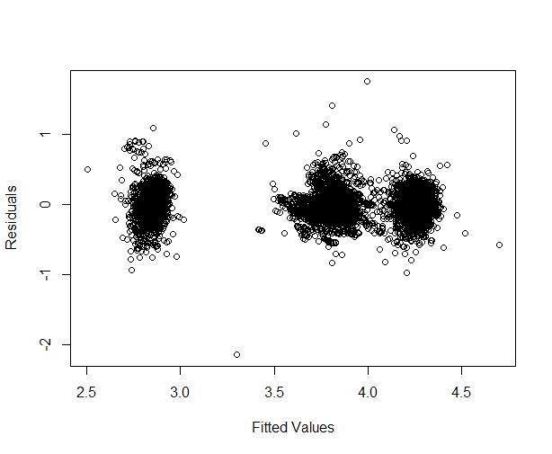
Residual Analysis: Constant Variance and Uncorrelated Errors
## Check Constant Variance & Uncorrelated Errors
full.fitted = fitted(fullmodel)
par(mfrow=c(1,1))
plot(full.fitted, full.resid, xlab="Fitted Values", ylab="Residuals")
Constant Variance Assumption
No pattern
Uncorrelated Errors Assumption
Three well-defined clusters
Spatial Dependence

Slide 8
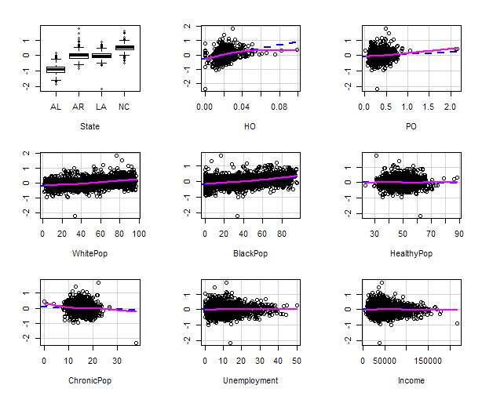
Residual Analysis: Linearity
## Check Linearity
crPlots(fullmodel, ylab="")

Slide 9
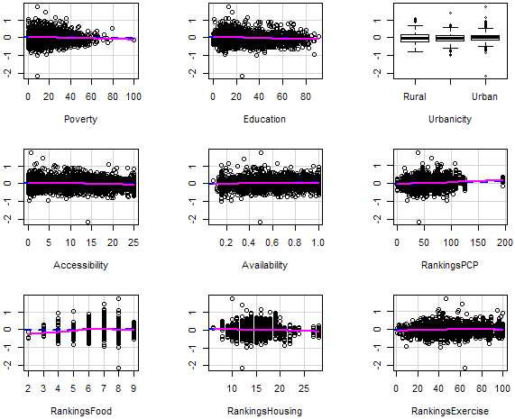
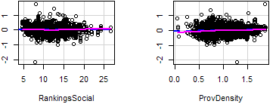
Residual Analysis: Linearity (cont’d)

Slide 10

Summary

